Slide 1
Transparent and replicable science
- an ongoing revolution
Rebecca Willén (PhD)
IGDORE
www.igdore.org

Slide 2
Today’s seminar
1. Bad science & the replicability revolution (20 min)
2. Good science & the open science revolution (15 min)
3. IGDORE – a private institute for good science (5 min)

Slide 3
Bad science & the replicability revolution

Slide 4
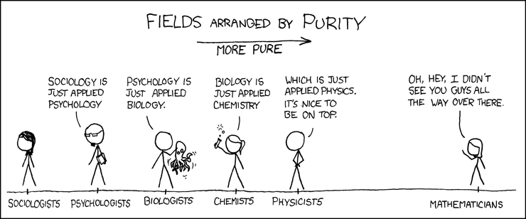
Comic: xkcd.com
Fanelli, D. (2010):
“Positive” Results Increase Down the Hierarchy of the Sciences
PLoS ONE 5(4): e10068.

Slide 5
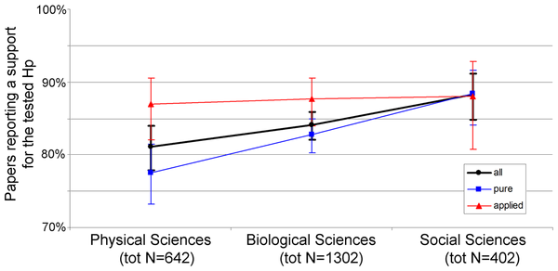

Figure 3. Positive Results by Disciplinary Domain.
Fanelli D (2010) “Positive” Results Increase Down the Hierarchy of the Sciences. PLOS ONE 5(4): e10068. https://doi.org/10.1371/journal.pone.0010068
http://journals.plos.org/plosone/article?id=10.1371/journal.pone.0010068

Slide 6
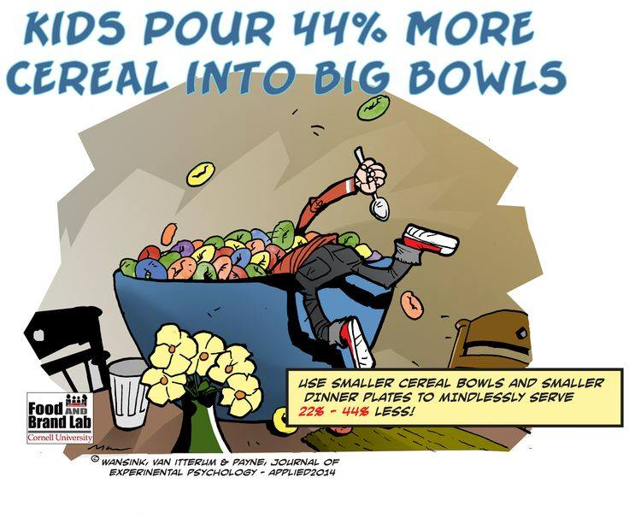
Disclosed bad science
Questionable Research Practices (QRPs) – self-disclosed
Health psychology
Cornell University
2016

Slide 7
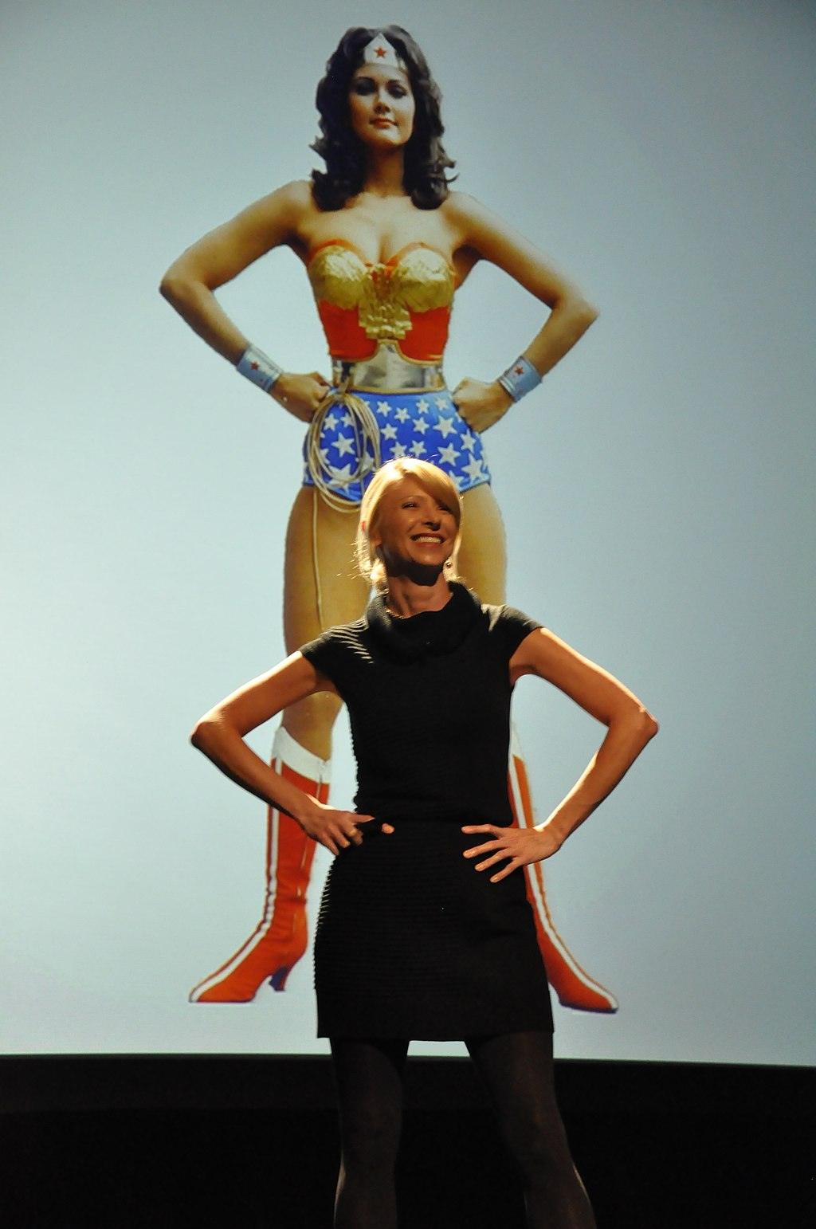
Disclosed bad science
Direct replications
Social psychology
Berkeley University &
Harvard University
2015
Photo: Wikimedia Commons

Slide 8
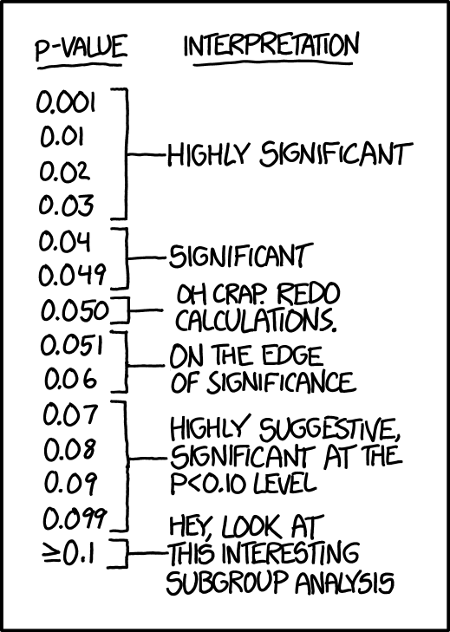
Disclosed bad science
QRPs – suspected by employer
Social psychology
University of Amsterdam
2014-2017
Comic: xkcd.com

Slide 9
Other examples
Basic & preclinical biomedical research (2009 – ongoing; Begley & Ioannidis, 2015)
Antipsychotic drugs (2017; Lancee et al, 2017, Nature)
Clinical trials in general (2011 – ongoing; e.g. Dawn et al, 2011, Cochrane)
Brain imaging (2012 – ongoing; e.g. Carp, 2012)
Social priming (2013 – ongoing; e.g. Klein et al, 2014)

Slide 10
Good science & the open science revolution

Slide 11
Open (good) practices
Preregistration
Distinguish between exploration & confirmation
Transparent reporting
Open data (& open code)
Open material
Open reports
Thorough planning of sample size
Direct replications
Honest author credits
Honest citations
Open peer review

Slide 12
Öppna (goda) praktiker
1. Preregistrering
Preregistreringsdokument:
Willén & Granhag (OGM-studien)
2. Skilja mellan explorativa & konfirmatoriska frågor
KONFIRMATORISK
1. Tydlig hypotes
2. Beslut om procedur för analys
3. Datainsamling
4. Analysen för att besvara hypotesen
EXPLORATIV
1. Vag hypotes / frågeställning
2. Datainsamling
3. Utforskande analyser och successivt utvecklande av frågeställningarna

Slide 13
Öppna (goda) praktiker
3. Transparent rapportering
21 ord (Simmons, Nelson, Simonsohn, 2012):
“We report how we determined our sample size, all data exclusions (if any), all manipulations, and all measures in the study.”

Slide 14
Öppna (goda) praktiker
Transparens i efterhand
Transparens i efterhand:
1. Dana Carney’s uttalande
2. Min doktorsavhandling
3. Min studie från 2010

Slide 15
Öppna (goda) praktiker
4. Öppna data (& kod)
5. Öppet material
6. Öppen rapportpublicering

Slide 16
Öppna (goda) praktiker
7. Gedigen planering av stickprovsstorlek
http://www.gpower.hhu.de/

Slide 17
Öppna (goda) praktiker
8. Direkta replikationer
Figur på nästa sida från LeBel et al (2017):
https://osf.io/preprints/psyarxiv/uwmr8

Slide 18
Öppna (goda) praktiker
9. Ärlig författarkreditering
10. Ärligt refererande
11. Öppen peer review
12. Öppen etikprövning

Slide 19
IGDORE – a private institute for good science

Slide 20

IGDORE
Healthy, Global & Transparent Science
Healthy science
Good work environment
Work-life balance
Global science
Wordwide recruiting
Worldwide data collections
Transparent science
Good science (open scientific practices)

Slide 21
Scientific openness support

Slide 22
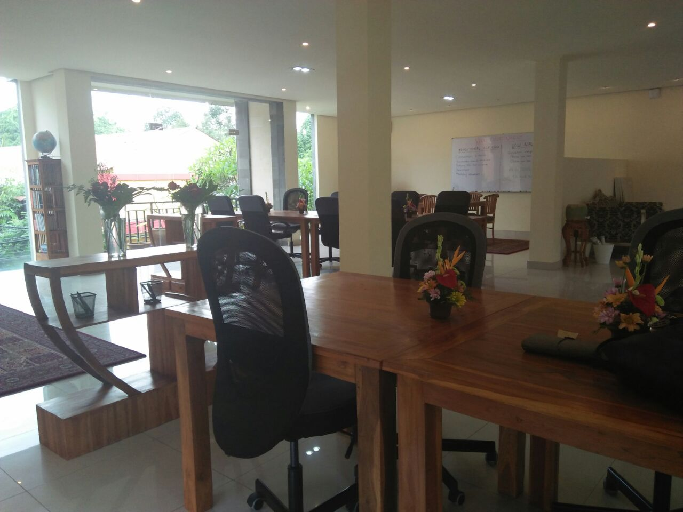
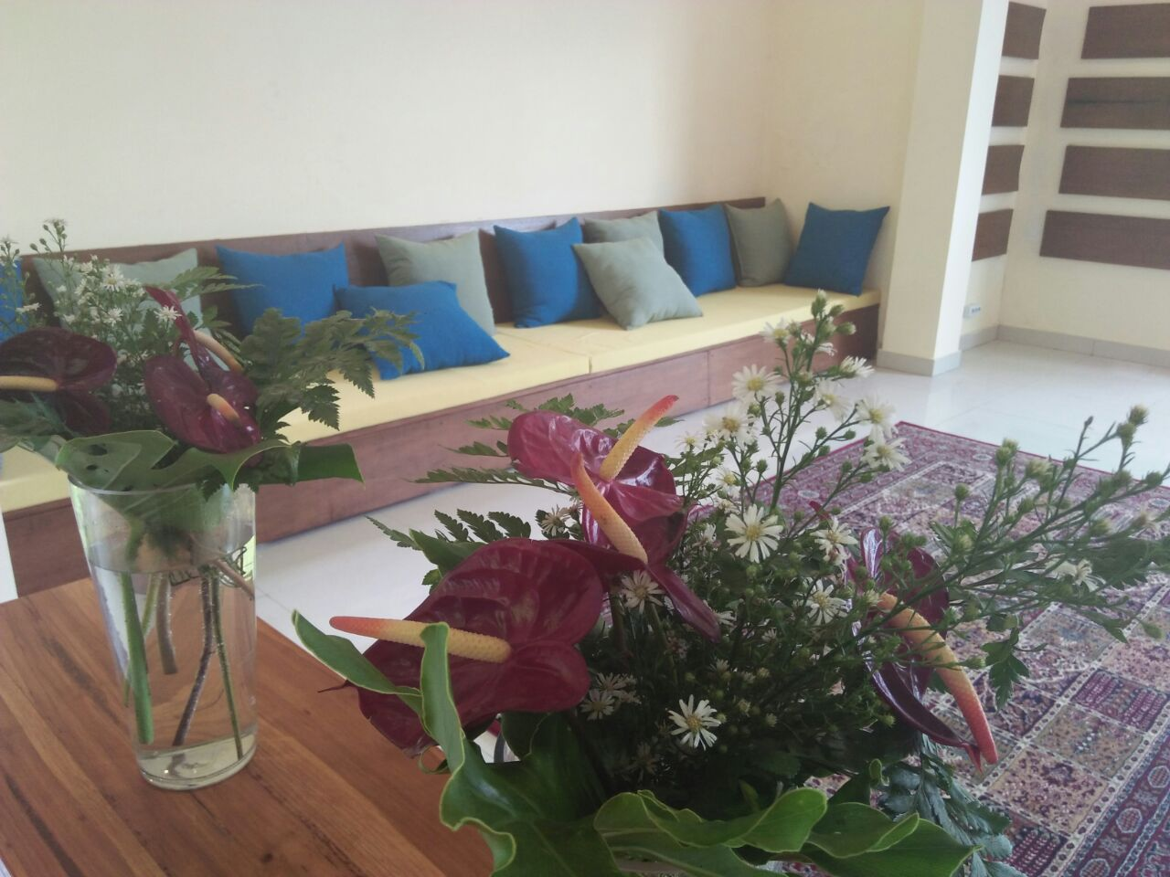
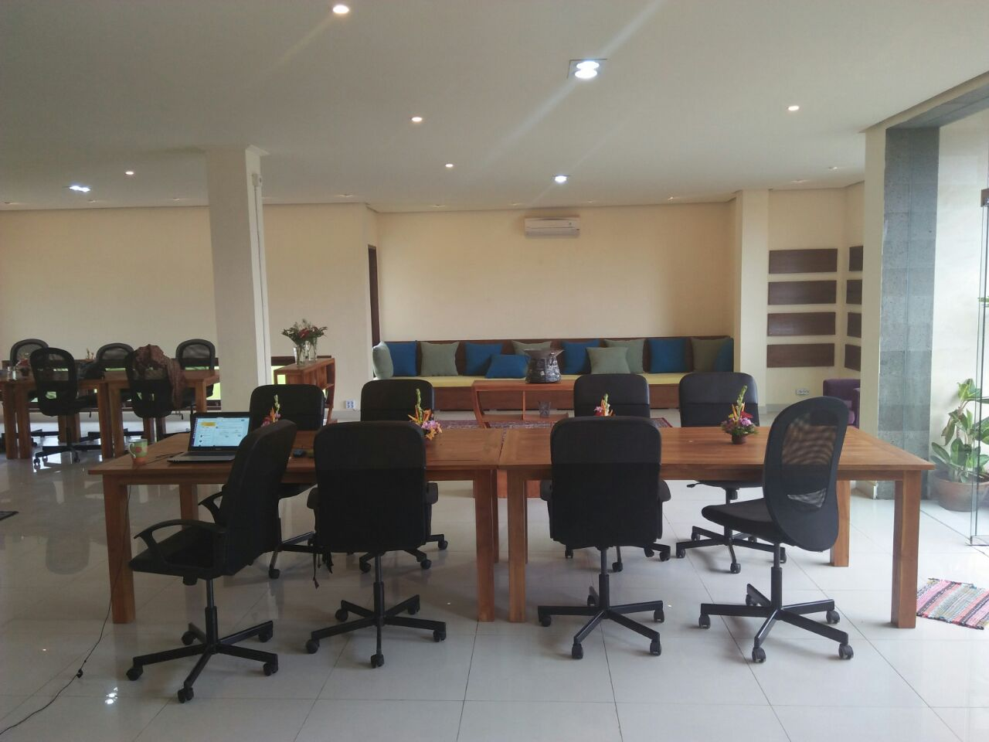
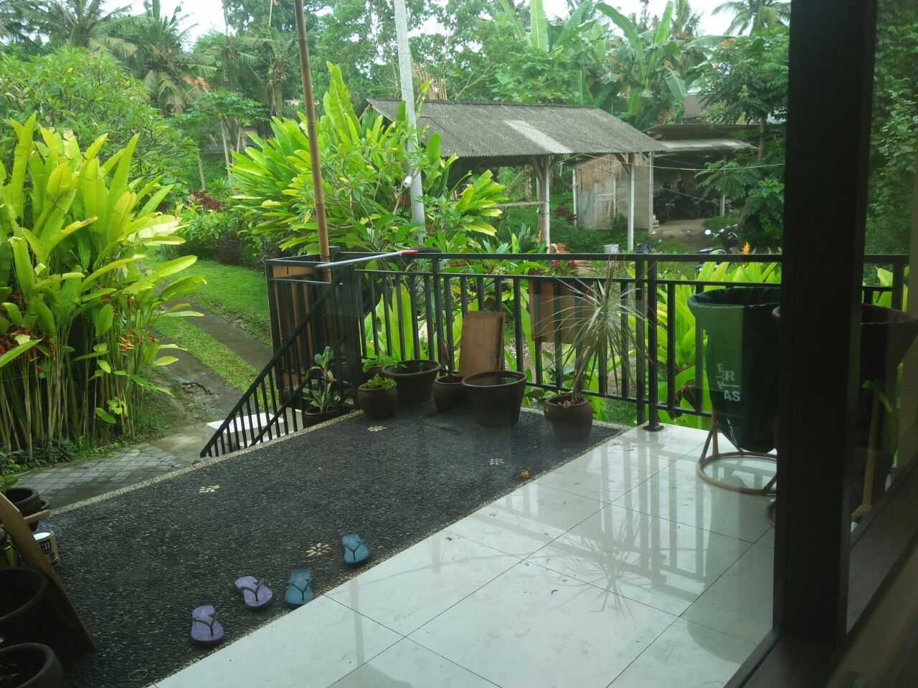
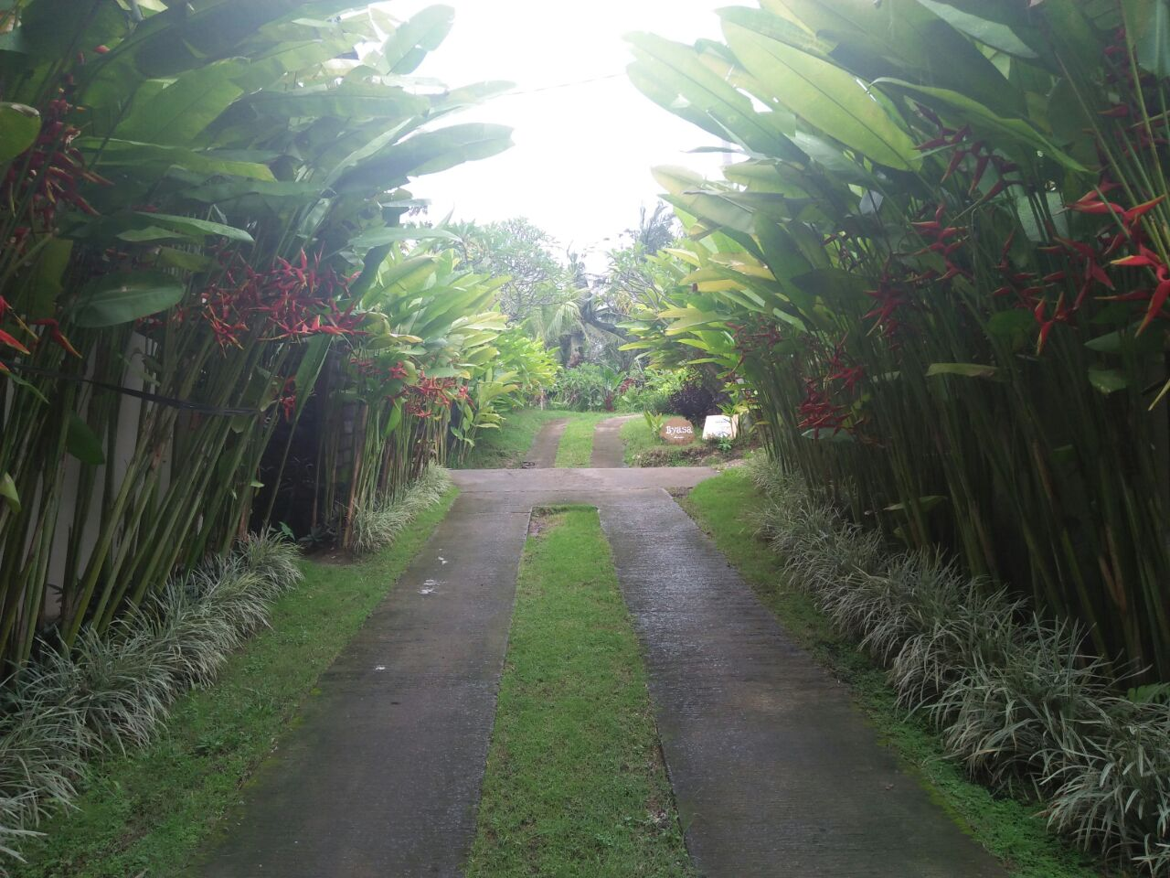
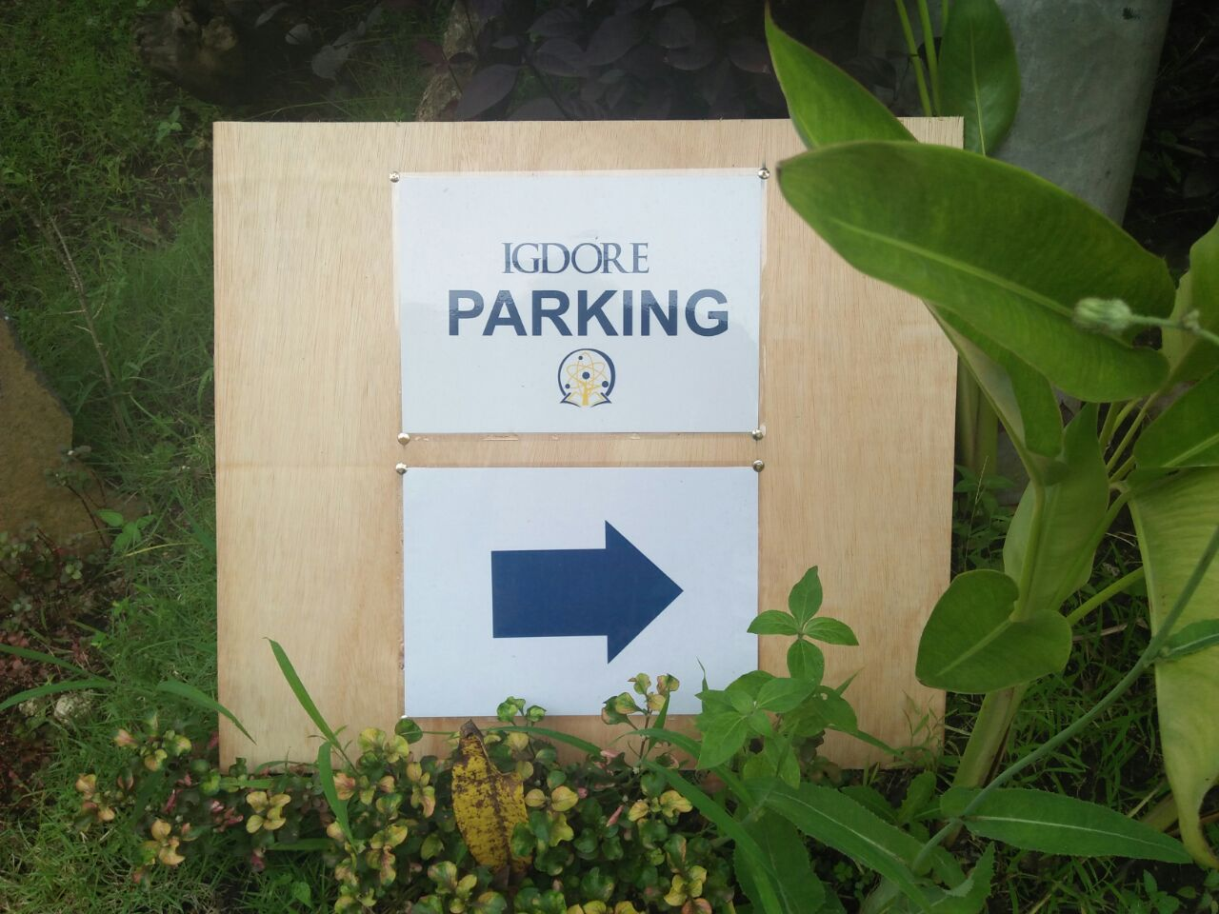
IGDORE Indonesia
Coworking space for scientists & students
rebecca.willen@igdore.org
Photos: Petra Sinatria, IGDORE

